Slide 1

Advanced Troubleshooting
Time to get technical!
Notes:
Main Title Page

Slide 2


Basic Networking

Slide 3
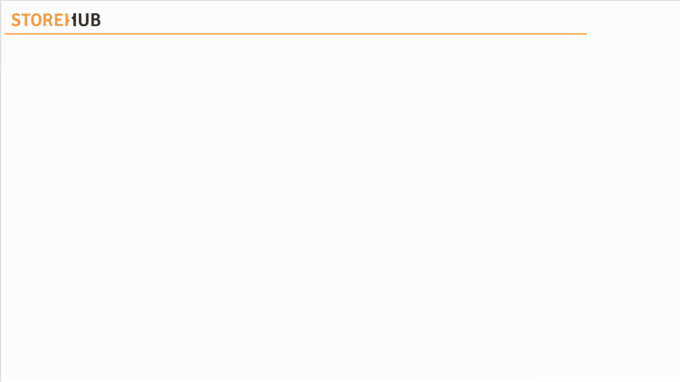
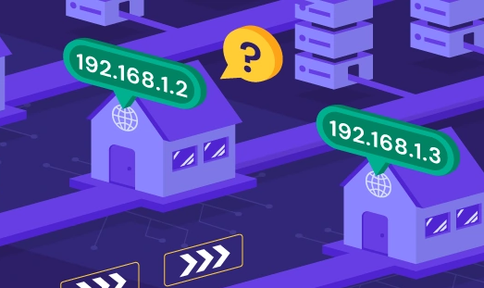
| Basic Networking
Introduction to IP Address
An identifier assigned to a device (computer, smartphone, tablet, printer, router, etc.) connected to a network.
Devices on the network use IP Address to identify & communicate with each other.
IP Address Format:
IPv4 (StoreHub Devices)
192.168.1.2
IPv6
2602:0445:0000:0000:a93e:5ca7:81e2:5f9d
IP = Internet Protocol

Slide 4
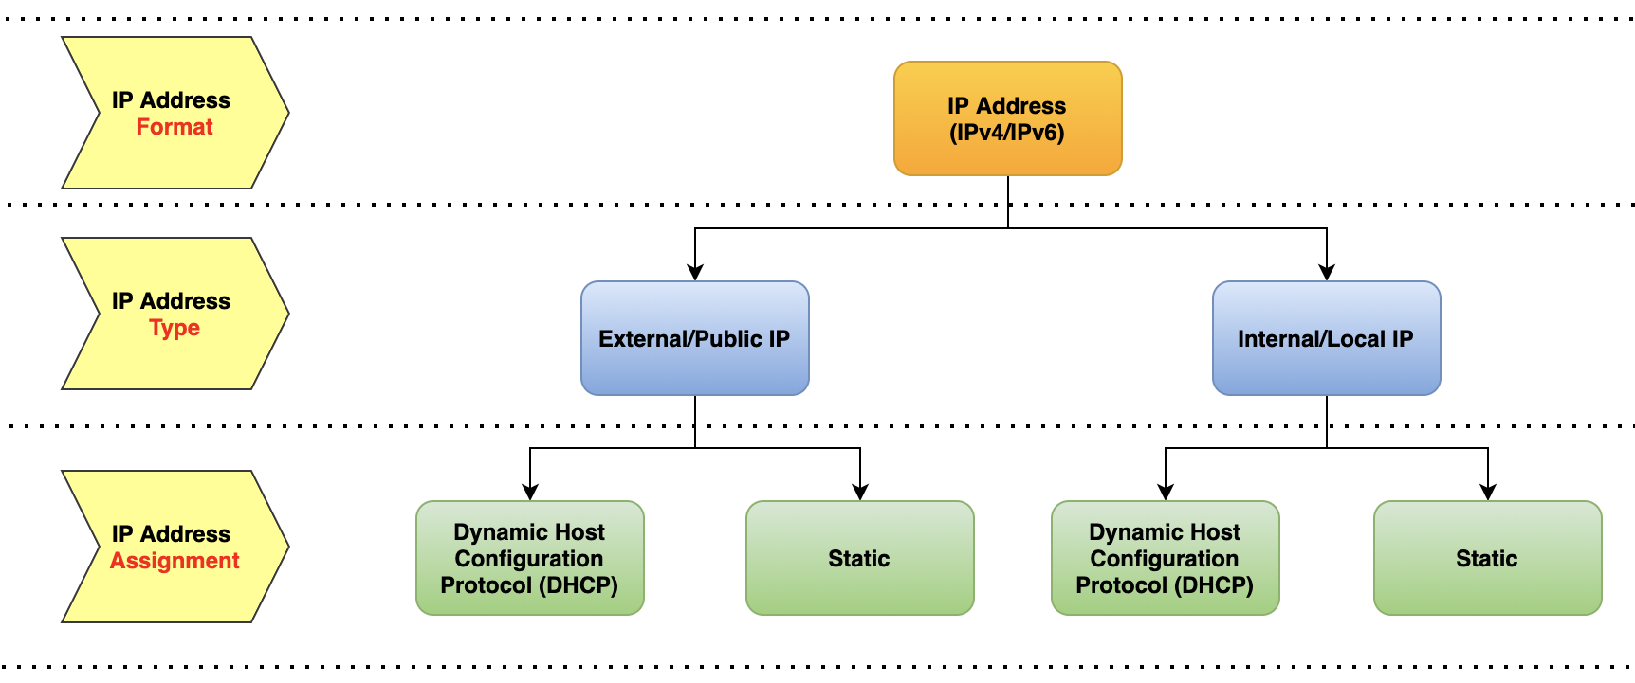
| Basic Networking
Introduction to IP Address
IP = Internet Protocol

Slide 5
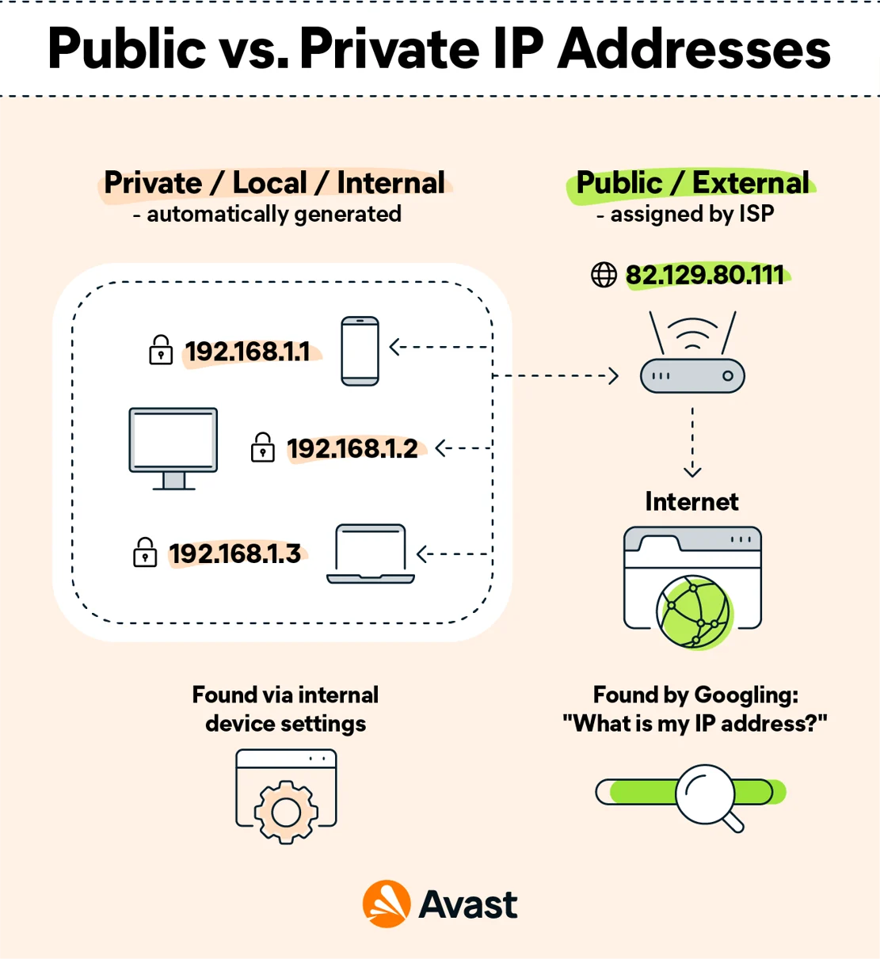
| Basic Networking
IP Address Type
Internal / Local IP is more relevant to StoreHub.
Router will assign a local IP Address to each of the devices which are connected to the router via LAN.
For StoreHub, Local IP Address assigned to our Mikrotik router > printers network is 10.1.8.x ( x = any number between 2-255)
10.1.8.1 is generally reserved for the Mikrotik router itself (Old TP-Link router sold by StoreHub : 10.1.2.1)
IP = Internet Protocol | ISP = Internet Service Provider

Slide 6

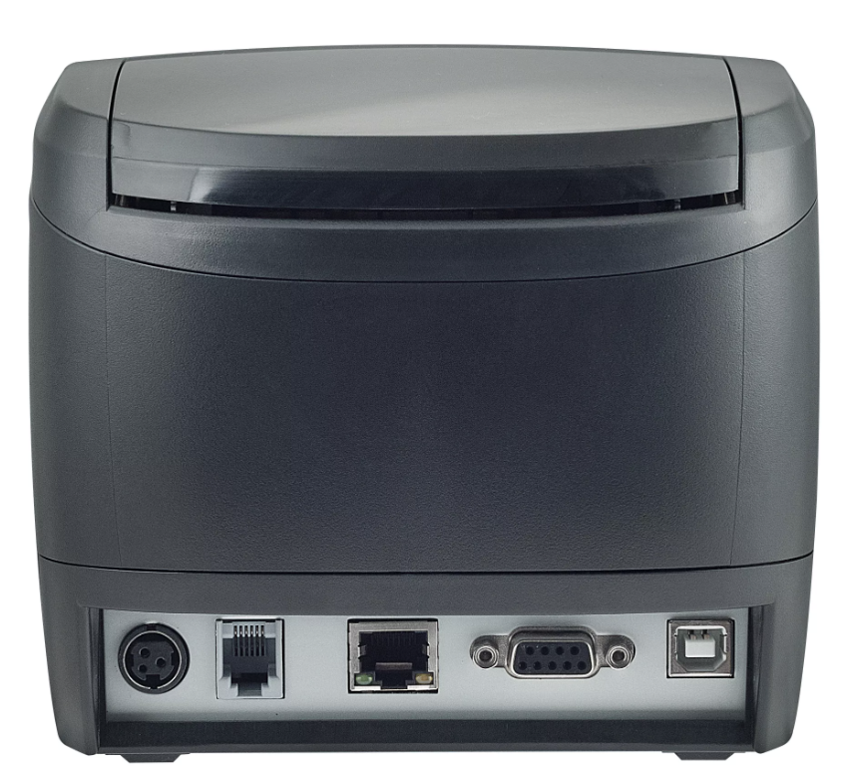
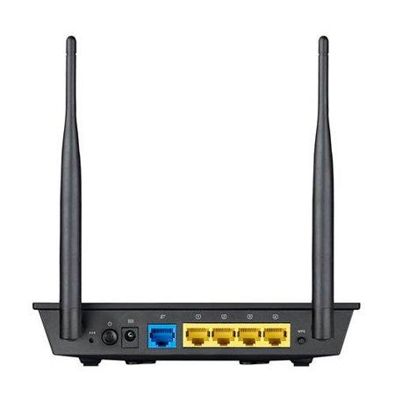
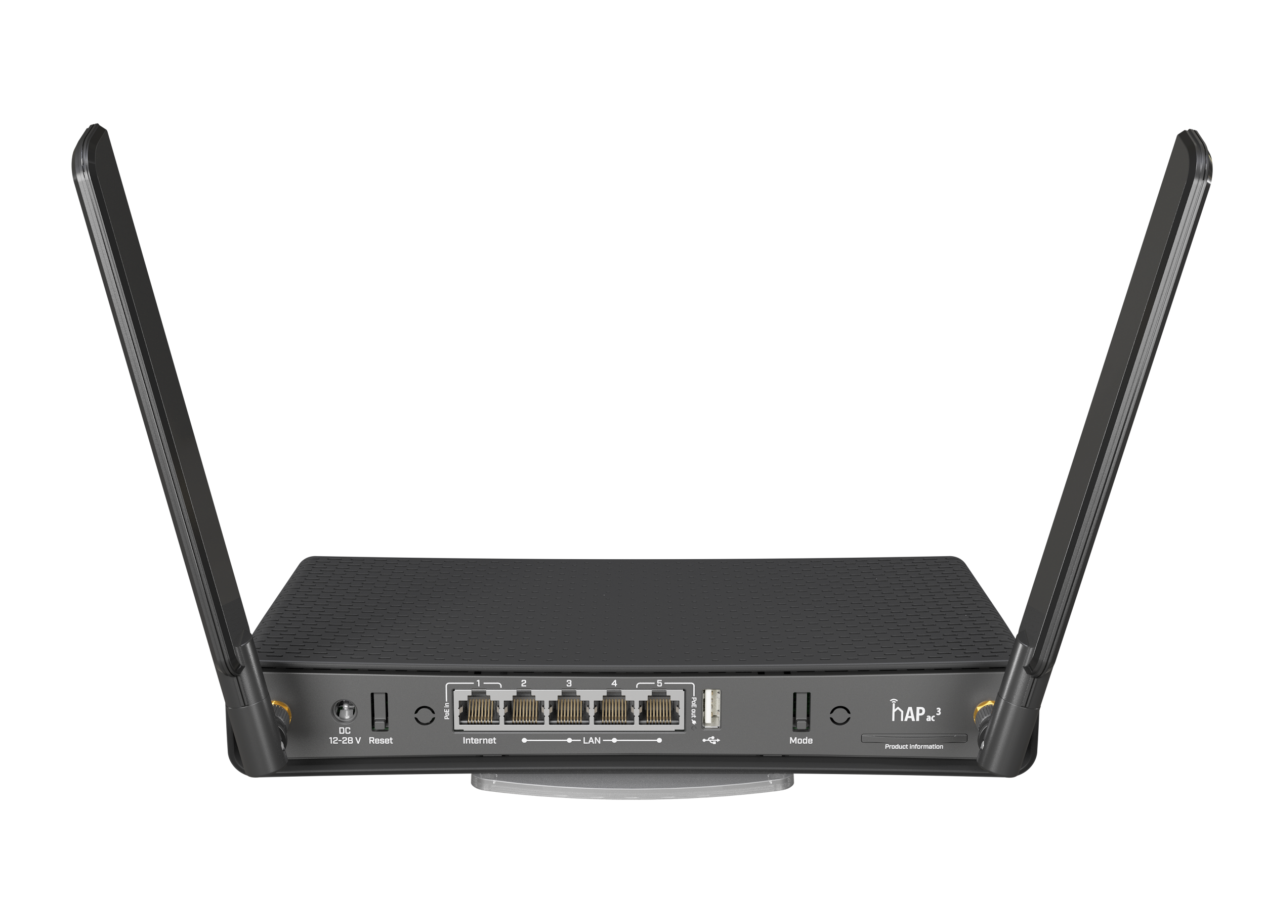



| Basic Networking
Example of a Network Connection
LAN Printers
10.1.8.2
LAN Printers
10.1.8.3
LAN Printers
10.1.8.4
ISP Router
192.168.1.1
StoreHub Router
10.1.8.1
LAN = Local Area Network | ISP = Internet Service Provider

Slide 7
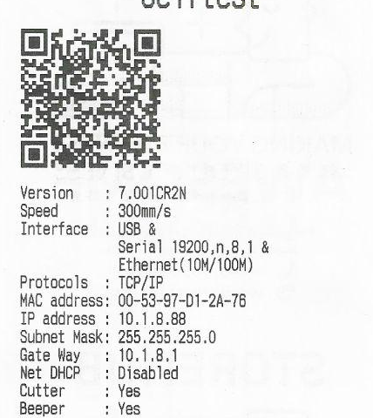

| Basic Networking
Subnet Mask
Subnet Mask defines which range of IP Addresses are within a local network and which ones are not.
For StoreHub, most commonly used Subnet Mask is 255.255.255.0 for all our router - printer networks.
IP = Internet Protocol

Slide 8
| Basic Networking
IP Address Assignment (DHCP / Automatic)
DHCP means IP Addresses for devices within the network changes based on specified range.
If DHCP = Enabled means device will “request” the DHCP Service for an IP Address from a configured pool. (Automatic IP Address Allocation)
If DHCP = Disabled means automatic IP Address allocation is disabled.
DHCP = Dynamic Host Configuration Protocol | IP = Internet Protocol

Slide 9
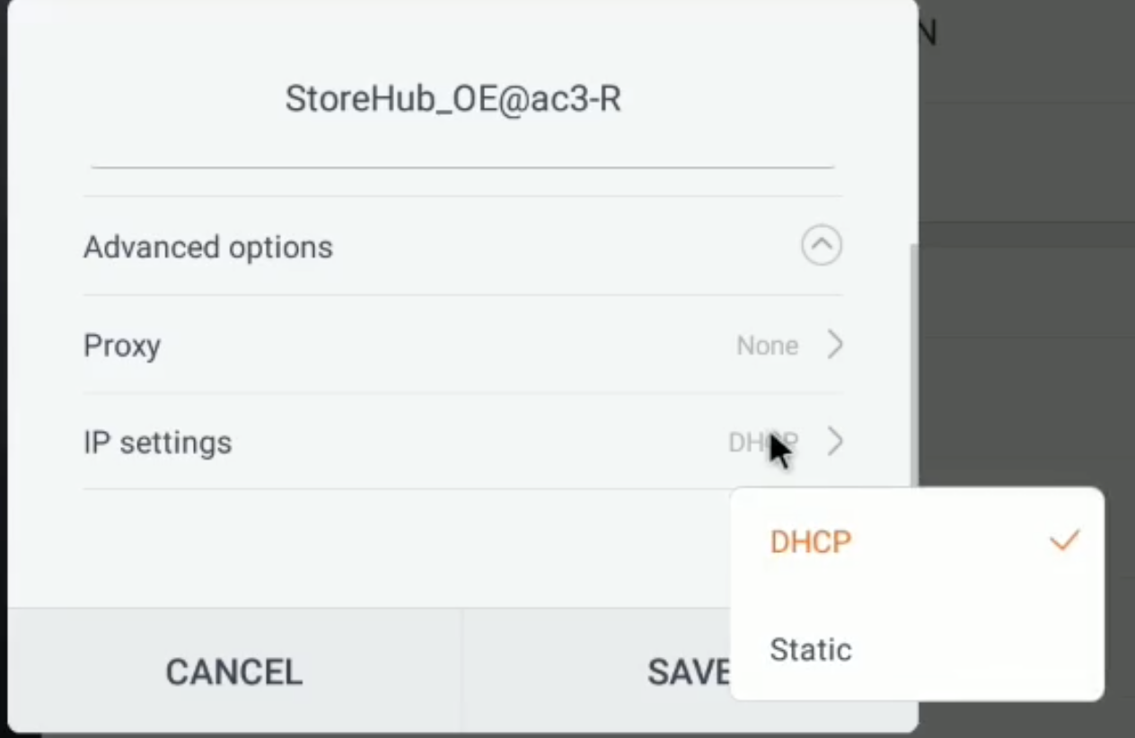
| Basic Networking
IP Address Assignment (Static / Manual)
IP Address that is permanently assigned to the network device by the router. It does not change even if the network device reboots.
The IP Addresses are assigned manually. When connecting to a new device IP Address, Subnet Mask & Gateway are required to be inputted manually.
IP = Internet Protocol

Slide 10
Hardware Troubleshooting

Slide 11
| Unable to Search XPrinter
Common Reasons
1
3
Wrong Wi-Fi Connection
Faulty
Hardware / Cable
Hardware Not Connected Properly
Printer Has Been Reset
2
4

Slide 12
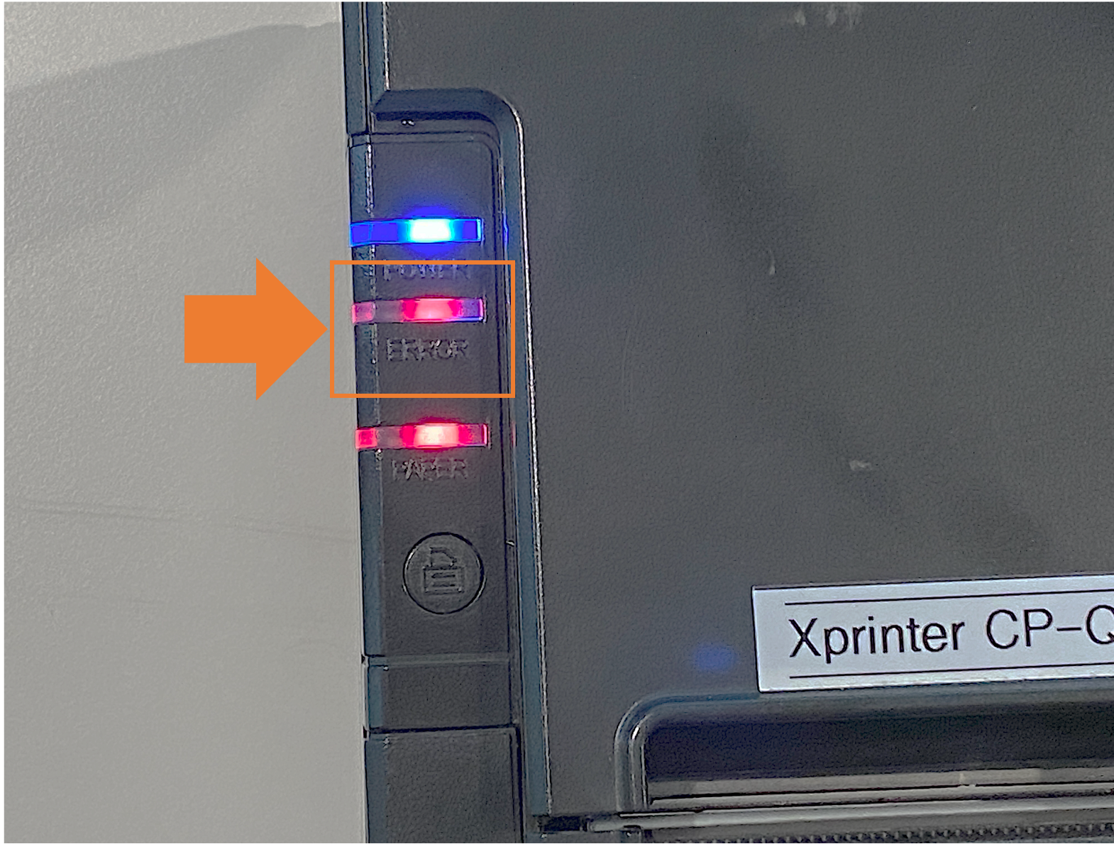
| Unable to Search XPrinter
Basic Network Check
Step 1:
1. Ensure Printer & SH Router are turned ON
2. Check Printer Error Light
Step 2:
If Printer Error Light ON
Check Receipt Roll
Search Printer & Test Print on POS App
If Printer Error Light OFF
Turn OFF the printer (wait 10 seconds) > then ON again.
Search Printer & Test Print on POS App
SH = StoreHub | POS = Point of Sale | APP = Application

Slide 13
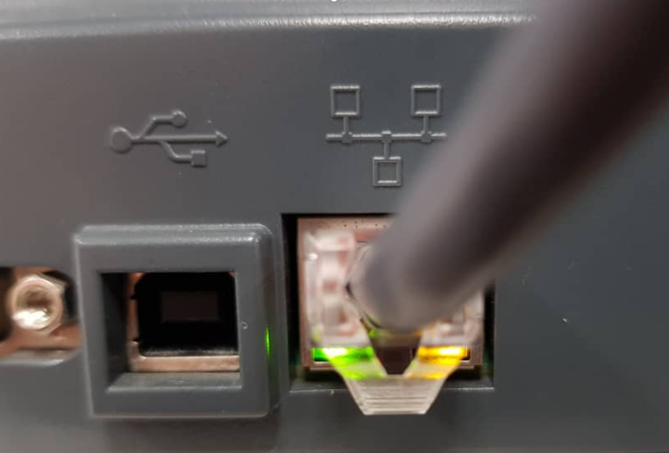
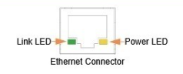
| Unable to Search XPrinter
Basic Network Check (Cont.)
Step 3 (If Printer is still not working):
Ensure LAN Cable is connected from SH Router (LAN Port) to Printer (LAN Port).
Ensure LAN Port status lights (Green & Orange) are ON.
The Ethernet Connector has 2 LED status indicator
Link LED (Green) : Indicates valid Printer – Ethernet connectivity
Power LED (Yellow/Orange) : Indicates power is ON
If Link LED (Green) is OFF : LAN Cable could be faulty or loose
If Power LED (Yellow/Orange) is OFF: Could be printer issue
SH = StoreHub | LAN = Local Area Network

Slide 14
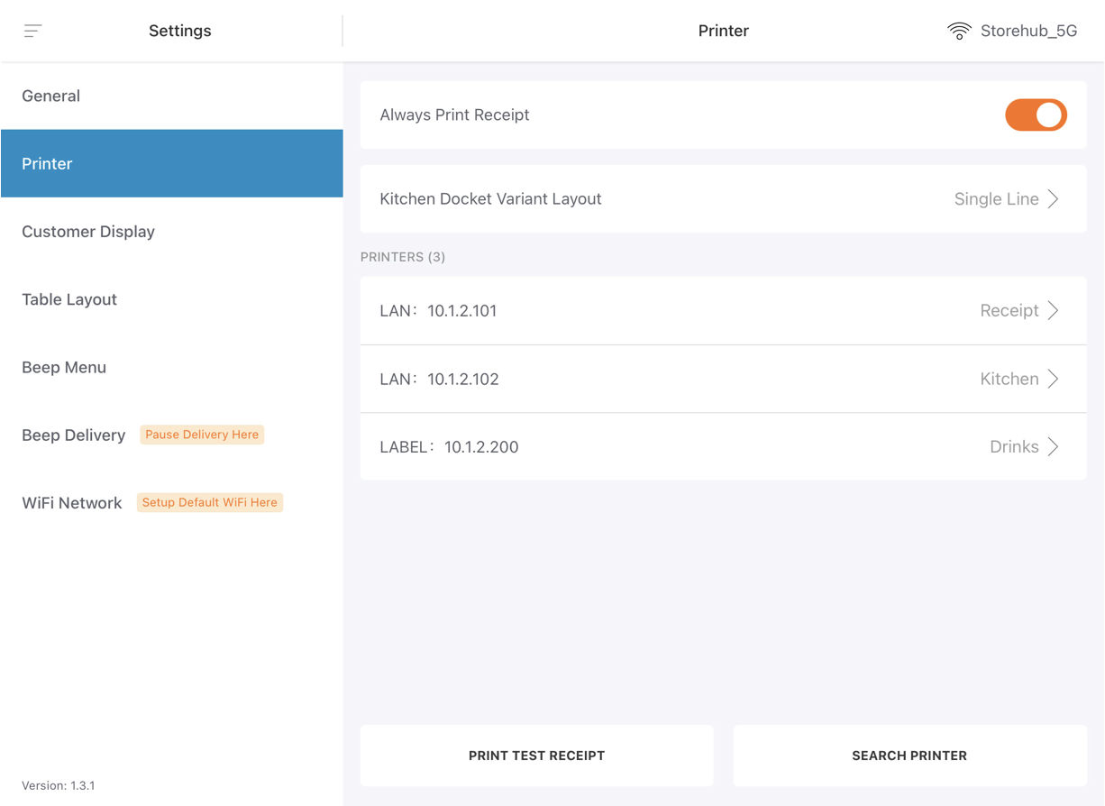
| Unable to Search XPrinter
Basic Network Check (Cont.)
Step 3 (Cont.):
Ensure POS devices are connected to StoreHub Router via WiFi.
Enable Local Network Settings (iPad Only)
Force quit & re-open StoreHub POS App.
Search Printer & Test Print

Slide 15
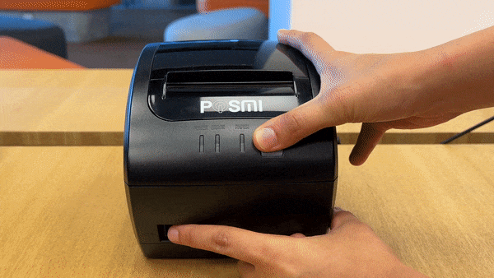
| Unable to Search XPrinter
Advanced Troubleshooting: Feed Test
Turn OFF the printer > press & hold the Feed button > While holding, turn ON the printer and release the feed button after 2 seconds.
Important Notes!
Do not keep finger on button for extended period of time!
Holding it for more than three seconds will reset the printer's settings.

Slide 16
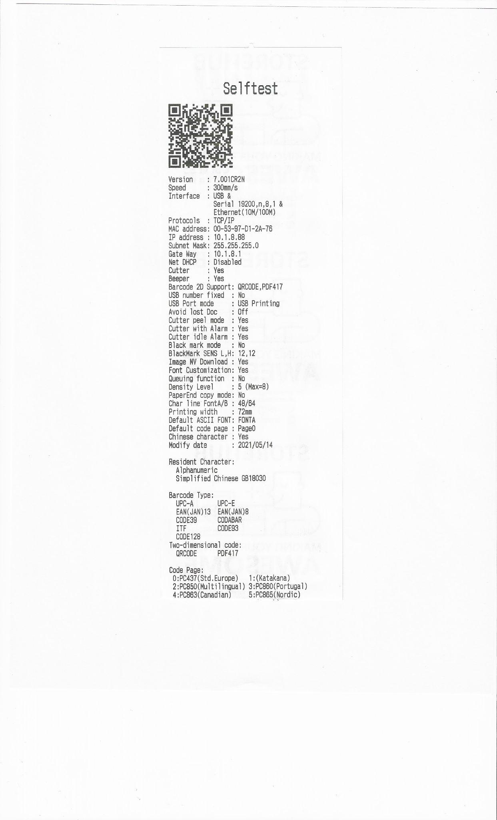
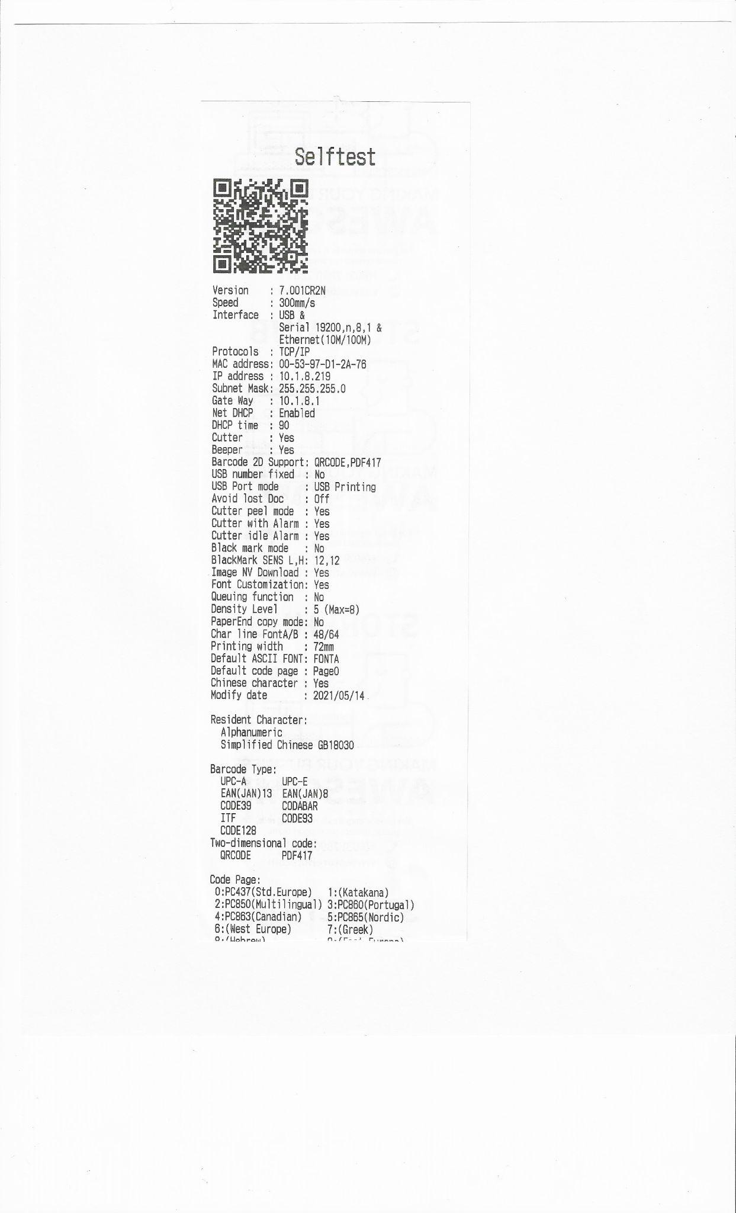
| Unable to Search XPrinter
Understanding Feed Test Result (Common Results)
Combination A
IP Address: 10.1.8.x / 10.1.2.x
Gateway: 10.1.8.1 / 10.1.2.1
Net DHCP: Disabled
Combination B
IP Address: 10.1.8.x / 10.1.2.x
Gateway: 10.1.8.1 / 10.1.2.1
Net DHCP: Enabled
DHCP = Dynamic Host Configuration Protocol | IP = Internet Protocol

Slide 17
| Unable to Search XPrinter
Understanding Feed Test Result (Combination A)
Combination A
IP Address: 10.1.8.x / 10.1.2.x
Gateway: 10.1.8.1 / 10.1.2.1
Net DHCP: Disabled
Solution:
1. Reset Network Settings (iPad)
2. Restart Printer
3. Re-open StoreHub POS App
4. Search Printer again.
Diagnose:
Printer most likely still within connection.
DHCP = Dynamic Host Configuration Protocol | IP = Internet Protocol

Slide 18
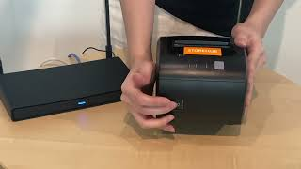
| Unable to Search XPrinter
Troubleshooting Video (Combination A - Android)

Slide 19
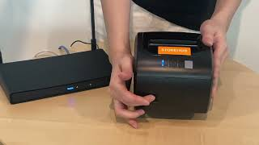
| Unable to Search XPrinter
Troubleshooting Video (Combination A - iPad)

Slide 20
| Unable to Search XPrinter
Understanding Feed Test Result (Combination B)
Combination B
IP Address: 10.1.8.x / 10.1.2.x
Gateway: 10.1.8.1 / 10.1.2.1
Net DHCP: Enabled
Diagnose:
DHCP: Enabled; There are possibilities printer might still be within connection but most likely will have connection issue.
Solution:
1. Reset Printer
2. Configure Printer
3. Fix IP Address
DHCP = Dynamic Host Configuration Protocol | IP = Internet Protocol

Slide 21
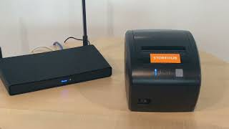
| Unable to Search XPrinter
Troubleshooting Video (Combination B - Android)

Slide 22

| Unable to Search XPrinter
Troubleshooting Video (Combination B - iPad)

Slide 23




| Troubleshooting - XPrinter
Common Issues
Printer Not Printing
Printer Print Blank
Printing Duplicate Receipts

Slide 24

| Troubleshooting - XPrinter
Not Printing Receipts / Kitchen Dockets
Ensure “Receipt” & Kitchen Printing tasks has been toggled ON on desired printer

Slide 25
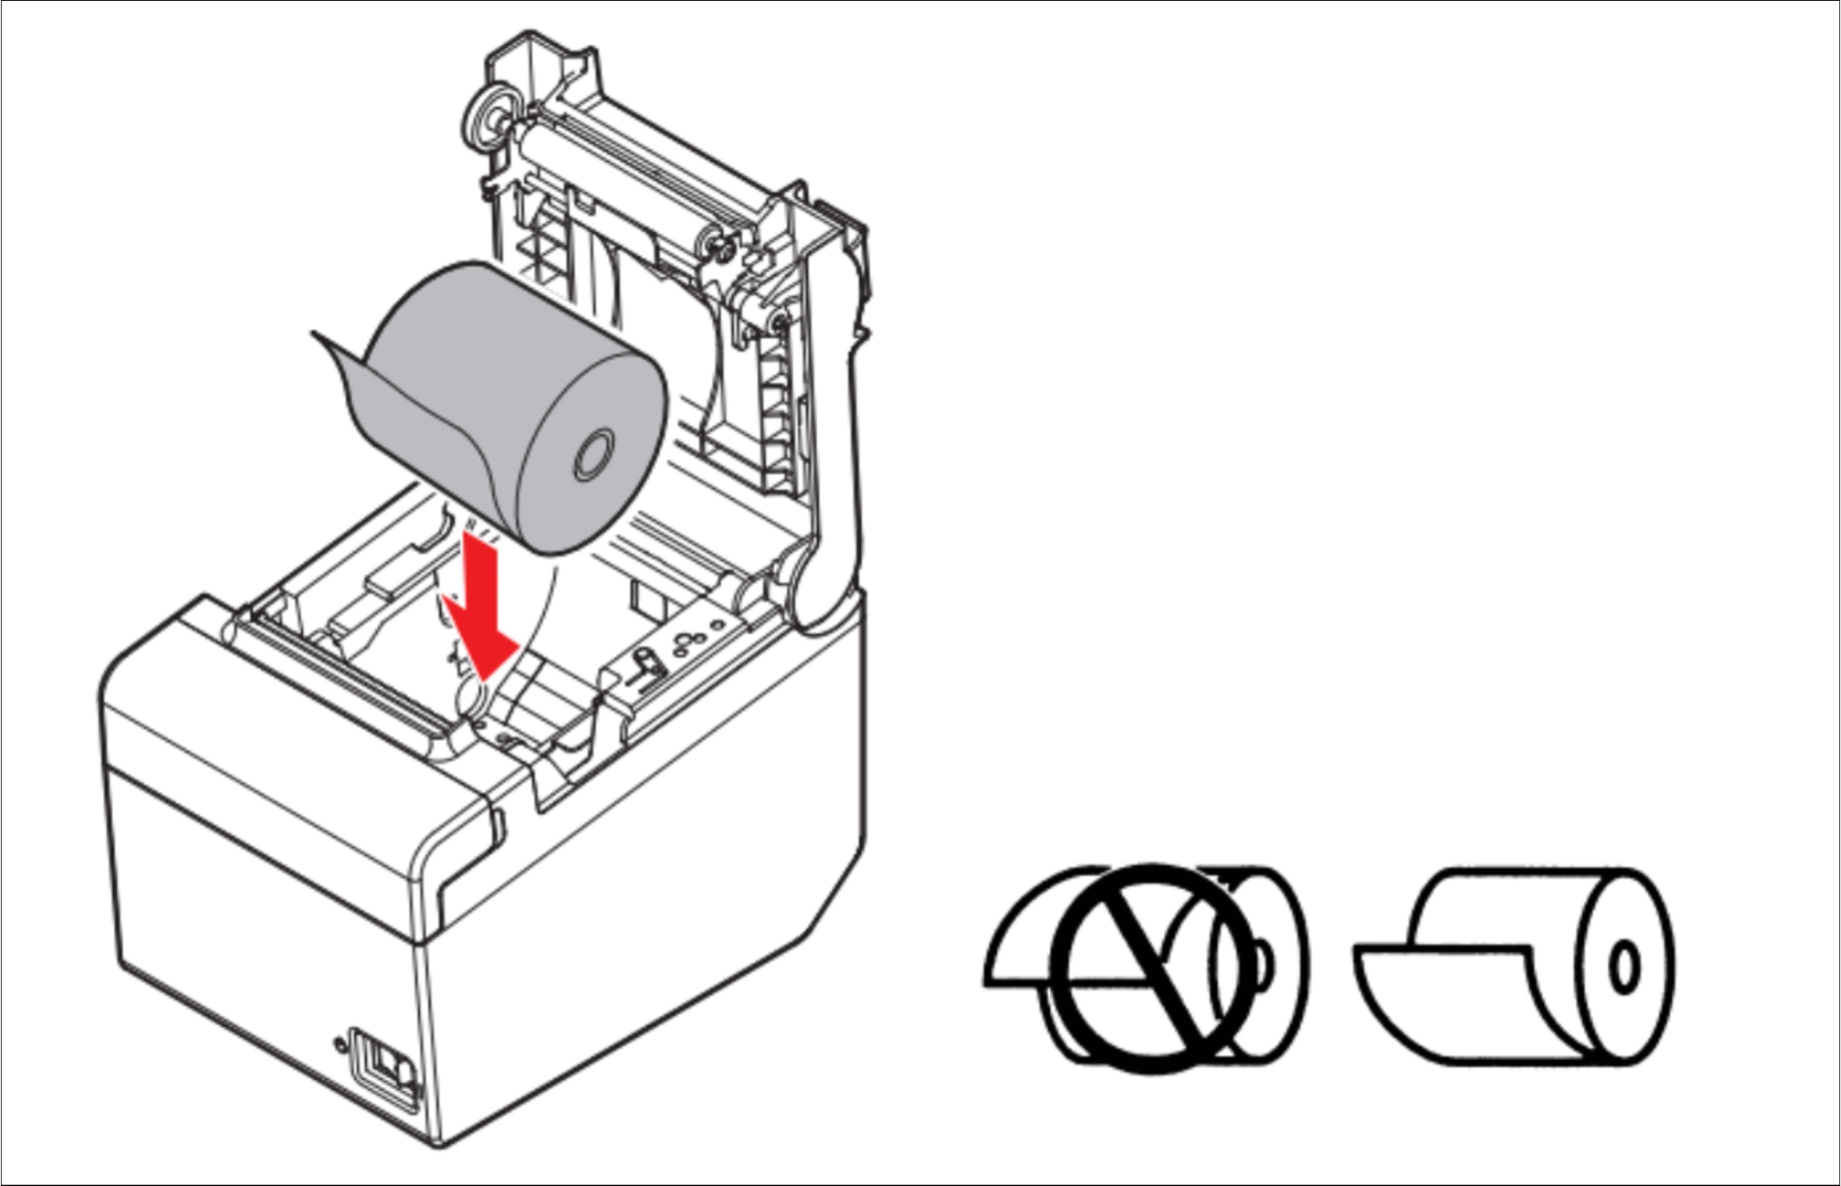
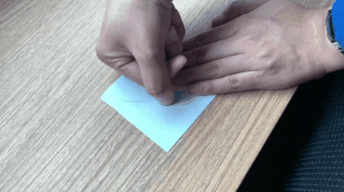
| Troubleshooting - XPrinter
Printing Blank Receipts
Use Thermal Receipt Paper
Scratch both sides of the paper.
If there are NO black dots or markings, then it is NOT thermal paper.
Place Receipt Roll Correctly
Receipt Roll should be oriented with the printed side (the side with black marks) facing upwards

Slide 26
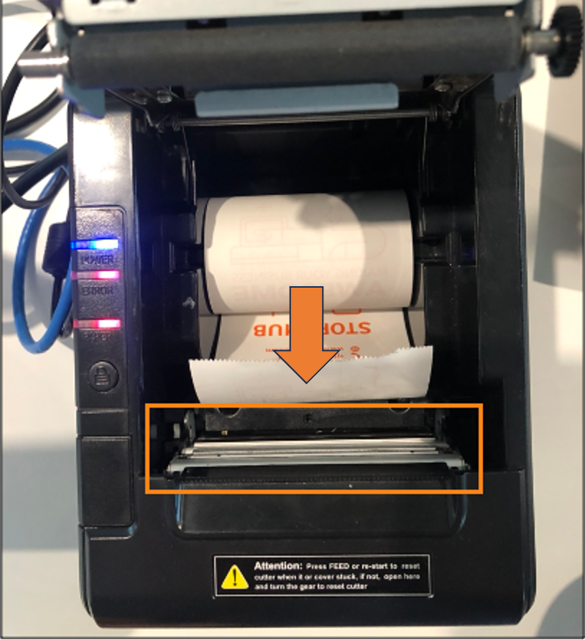


| Troubleshooting - XPrinter
Printing Blank Receipts
Ensure Thermal Pad is clean
Ensure nothing is stuck on thermal pad.
Clean thermal pad using dry cloth
Place printer in correct environment
Place printer in dry environment. (Avoid high humidity or elevated temperatures areas)

Slide 27
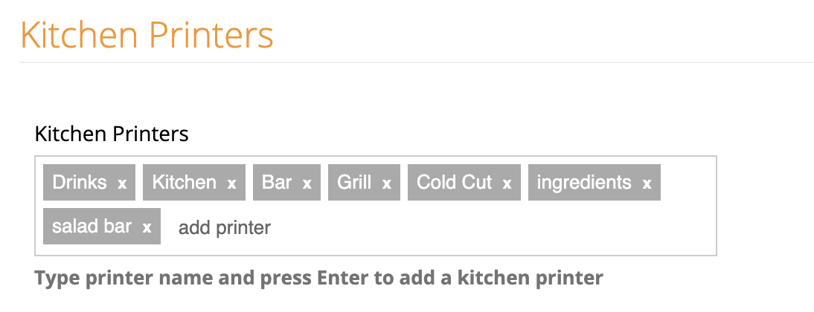
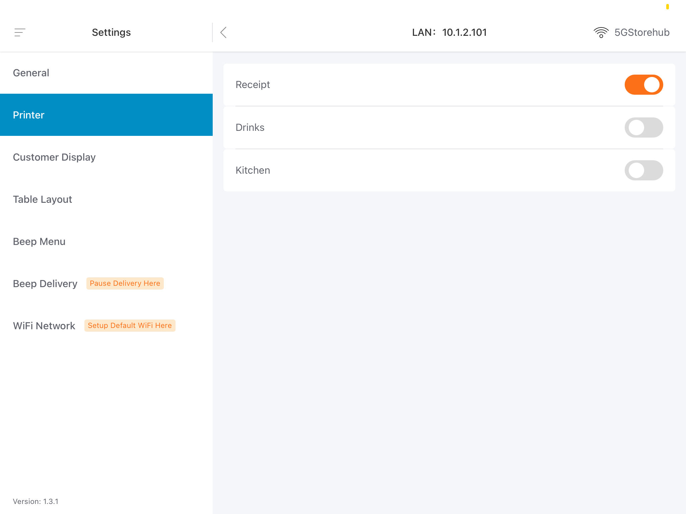
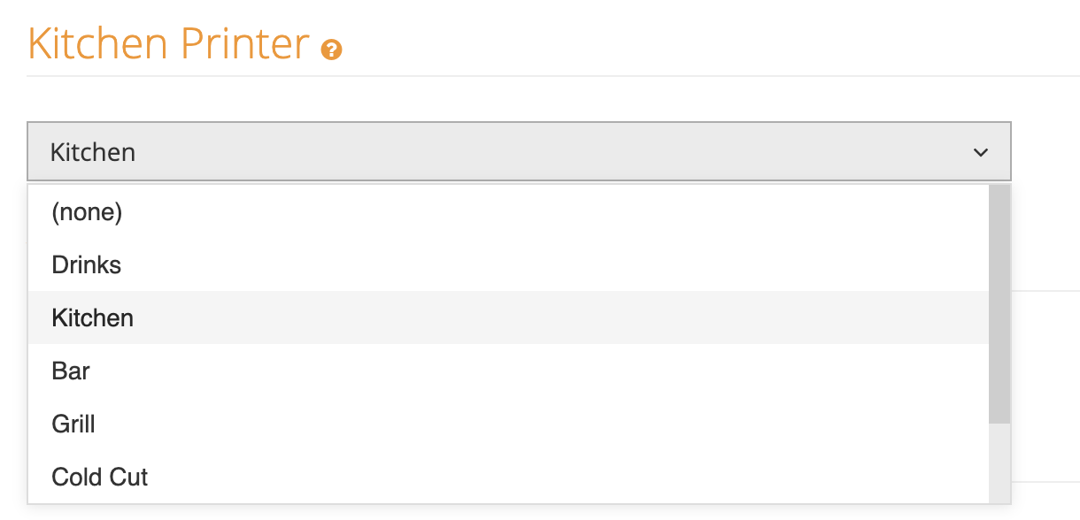
| Troubleshooting - XPrinter
Printing Duplicate Receipts / Kitchen Dockets
Ensure Printers has been set up in BO
Add Printers in BO & assign kitchen printers to all products.
Ensure Printers are toggled ON to print on POS
Toggle ON desired printers to print kitchen dockets.
Toggle ON Always Print Receipt.
BO = BackOffice

Slide 28
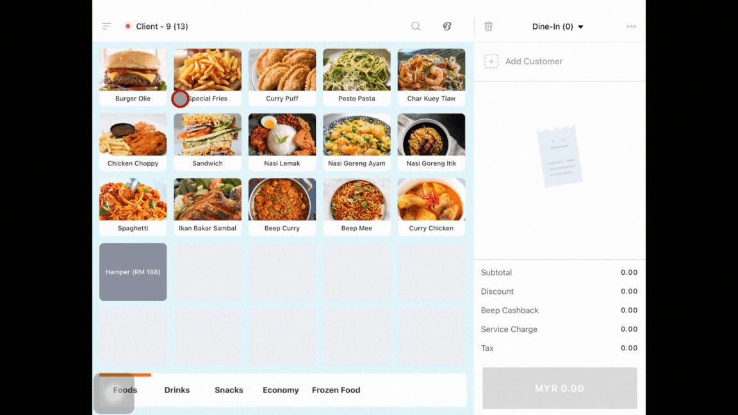
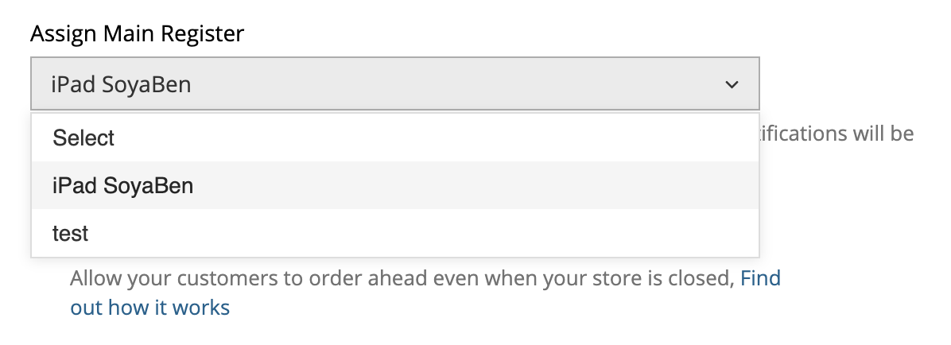
| Troubleshooting - XPrinter
Printing Duplicate Receipts / Kitchen Dockets
Ensure main POS Register is assigned (Beep Users)
In BackOffice Store Settings page, click on store.
On Sell Online tab, assign Main Register.
Ensure Beep Orders status is not in New Order (Beep Users)
If the Beep order is accepted/completed, ensure the order is not in New Order Status with Kitchen dockets printed.
If order remains in New Order Status. Trigger the kitchen dockets to print again by selecting “Send To Kitchen”.
POS = Point of Sale

Slide 29
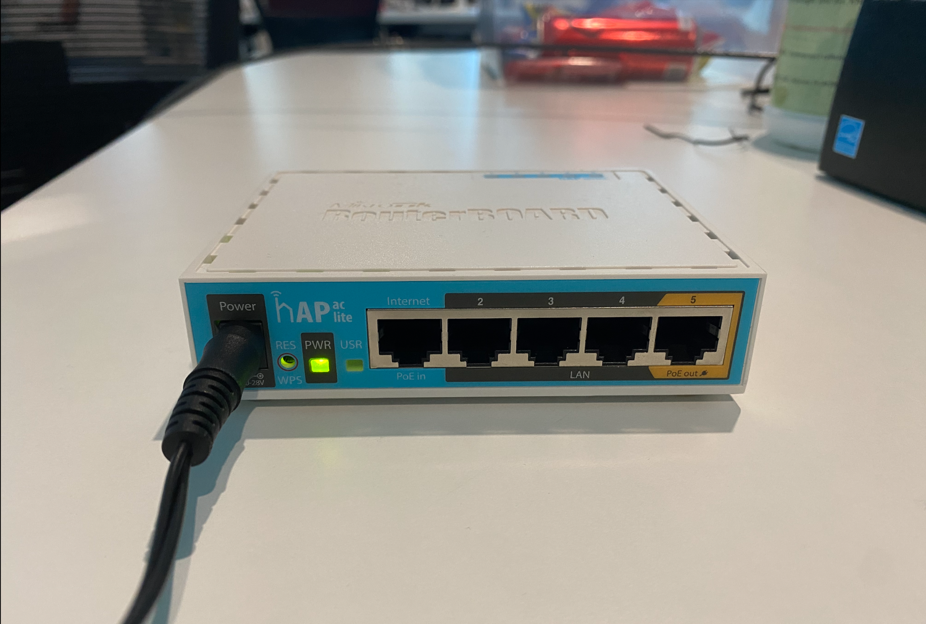
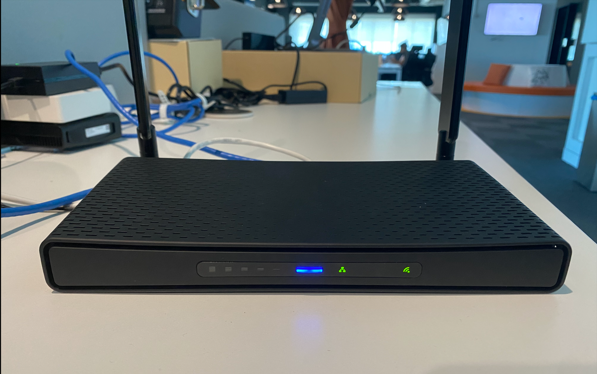
| Troubleshooting - Mikrotik Router
Basic Check
Ensure router power is plugged in & power light is ON.
If power light is OFF:
Change power outlet of the router
If power light is ON (but no internet):
Ensure the SH Router (WAN Port) is connected to ISP Router (LAN Port).
Ensure the LAN Cable connected is not loose & cable head is in good condition/
WAN = Wide Area Network | LAN = Local Area Network

Slide 30
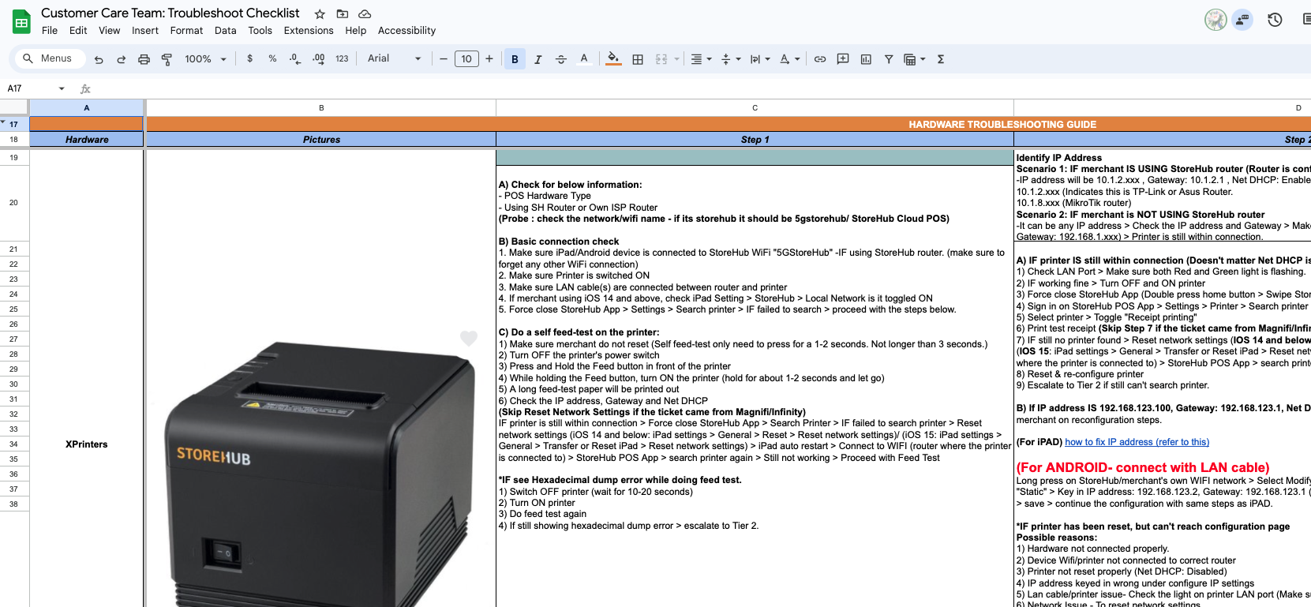
| Troubleshooting - XPrinter
Troubleshooting Checklist
Refer to this link for the full checklist

Slide 31

CULTIVATE
THIS DOCUMENT IS STRICTLY PRIVATE AND CONFIDENTIAL. THIS IS INTENDED FOR INTERNAL USE ONLY; DO NOT CIRCULATE
Copyright © 2022 Storehub. All rights reserved. No parts of this document can be reproduced, distributed, transmitted or stored electronically without Storehub’s prior written permission.

